Slide 1


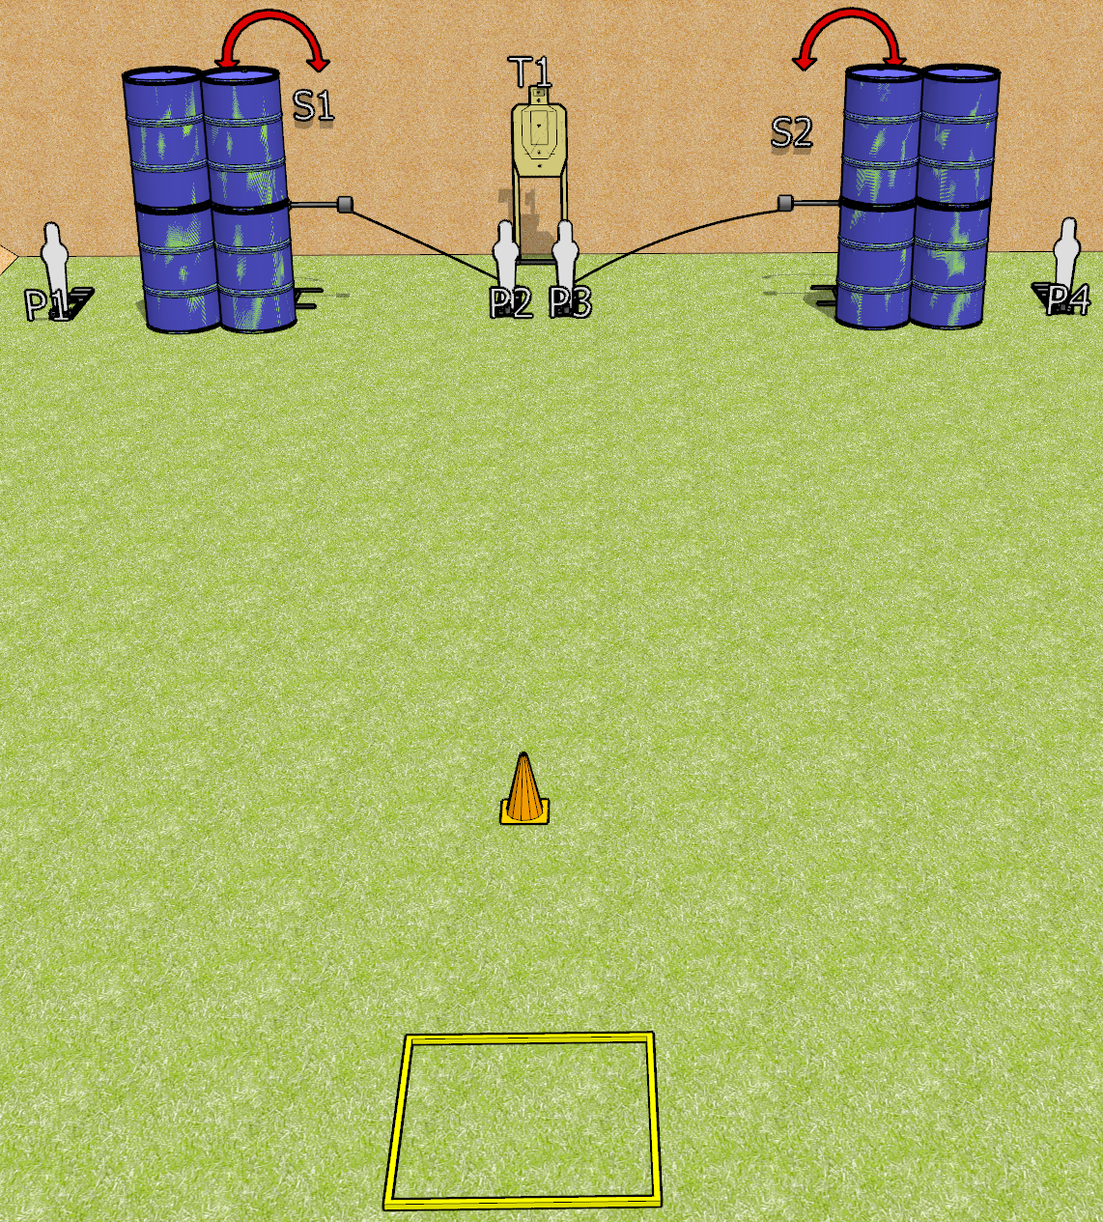
 | Dothan Gun Club – USPSA Match Speedy Course Designer : Drew Coleman
START POSITION : Standing in shooting box, wrists below belt
GUN READY CONDITION : Pistol loaded and holstered. PCC loaded, held with both hands, shouldered, safety on, pointed at orange cone. |  | SCORING: Comstock, 10 rounds TARGETS: 3 paper, 4 Steel SCORED HITS: Best 2 on paper, steel until down START-STOP: Audible, last shot RULES: Failure to perform a mandatory reload will incur a procedural per shot fired.
STAGE PROCEDURE: Engage P1-P4 OR T1, perform a mandatory reload, then engage the remaining array. S1 and S2 may be engaged at any time.

Slide 2
Speedy
Written Stage Briefing
Speedy is a 10 round, 50 point, Comstock speed shoot. There are three USPSA targets and four mini poppers. The best two hits on paper will score, and steel must fall to score.
P2 activates S1, and P3 activates S2. Please check all activators prior to walkthrough and set them same way for each shooter.
Handgun start position is standing in shooting box, wrists below belt. Handgun is loaded and holstered.
PCC start position is standing in shooting box, muzzle pointed at orange cone. Loaded carbine is held with both hands, shouldered, safety on.
On start signal, engage P1-P4 OR T1, perform a mandatory reload, then engage the remaining array. S1 and S2 may be engaged at any time.

